Slide 1
HVAC Components

Slide 2
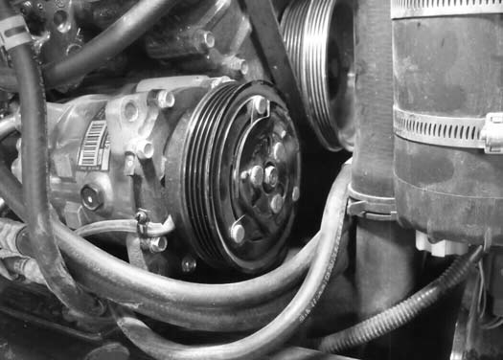
COMPRESSOR
The compressor is the pump that circulates the refrigerant throughout the system. It raises the pressure of the refrigerant for heat transfer through the condenser and evaporator.
The A/C system (Compressor) is recommended to be turned on for at least 5 minutes weekly throughout the year to lubricate the internal components.

Slide 3
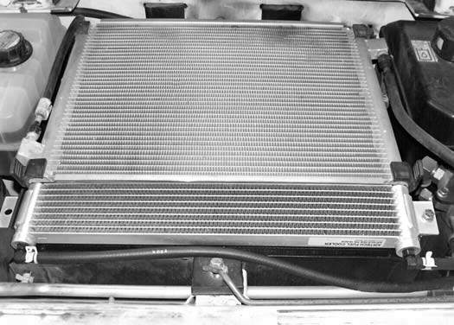
CONDENSOR
The condenser is
the unit that receives the high pressure, high temperature refrigerant vapor from the compressor and condenses it into a high temperature liquid.

Slide 4
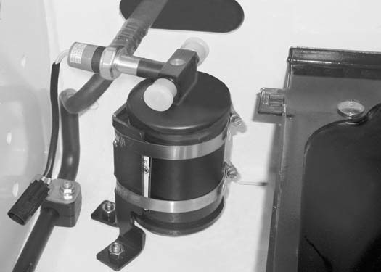
RECEIVER / DRIER
The receiver / drier is the unit that receives the liquid refrigerant from the condenser and removes moisture and foreign matter from the system. It also serves as a storage tank for the extra liquid refrigerant until it is needed by the evaporator.
Note!!! Both fittings on the drier are the same size, so the hoses can be hooked up incorrectly.

Slide 5
RECEIVER / DRIER
Sight glass: The sight glass can be used to determine if the system is low on refrigerant. If bubbles are present in the sight glass, it is likely that the system is low on refrigerant.
Pressure Switch: The pressure switch will disengage the compressor clutch at high pressure readings over 384 psi on the high side, or at very low pressure of 28 psi or less on the high side, which indicates loss of refrigerant.

Slide 6
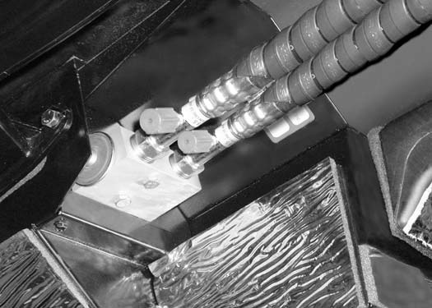
EXPANSION VALVE
The expansion valve controls the amount of refrigerant entering the evaporator coil.
Pressure ports

Slide 7
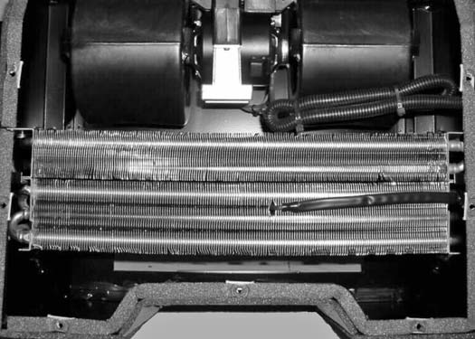
HEATER / EVAPORATOR UNIT
The blower is used to push air through the heater and
evaporator coils and into the cab.
The heater coil supplies the
warm air into the cab by passing air through the coil.
The evaporator coil cools and dehumidifies the air before it
enters the cab.
The thermostat controls the temperature of the evaporator coil.

Slide 8
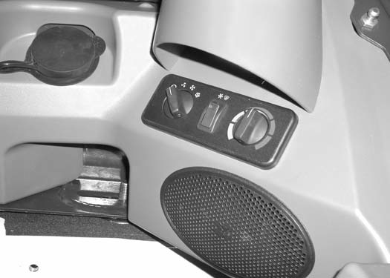
CONTROL PANEL
Fan Switch: This is a four position rotary switch . When the fan switch is in the off position the A/C will not engage, but the heat valve will operate, as it is controlled by the key switch.
A/C Switch: The rocker switch will be illuminated when the A/C is engaged.
Potentiometer: The potentiometer controls the Heat Valve from fully Off to fully On. This can be used in conjunction with the A/C for defrost of the windows and temperature control.

Slide 9
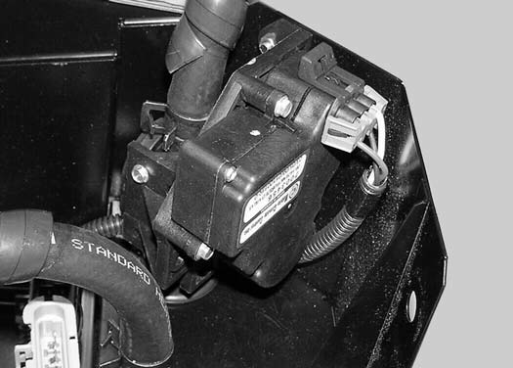
HEATER VALVE
The heater valve is used to control the amount of engine coolant that flows to the heater coil.

Slide 10
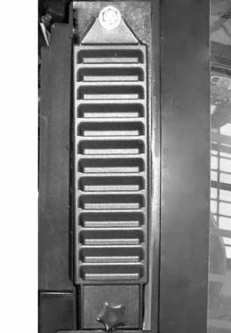
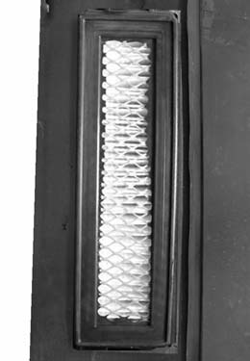
FRESH AIR FILTERS
Shake the filter or use low pressure air to remove dirt. This procedure can be done several times before replacement is required.

Slide 11
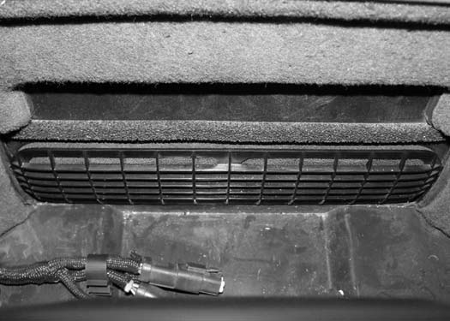
RECIRCULATION FILTER
The recirculation filter is located behind the operator’s seat inside the operator cab. The filter cover is held in position with three clips. Pull the cover at each end to remove.
Rinse the filter elements with water or use a vacuum to clean. Do not use solvents.

Slide 12
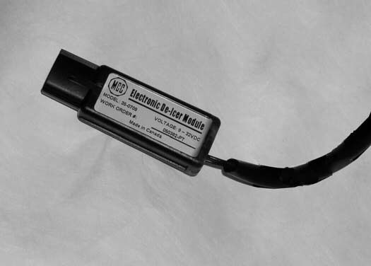
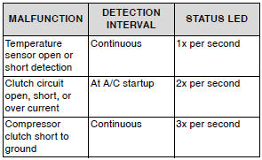
EDT – ELECTRONIC DE-ICING THERMOSTAT
The EDT has the following protection built in:
1. Over temperature
2. Over current from clutch output
3. Voltage (Above and below operational limits or reverse voltage)
4. Short protection (Output shorted to ground)
5. Temperature sensor open and short detection

Slide 13
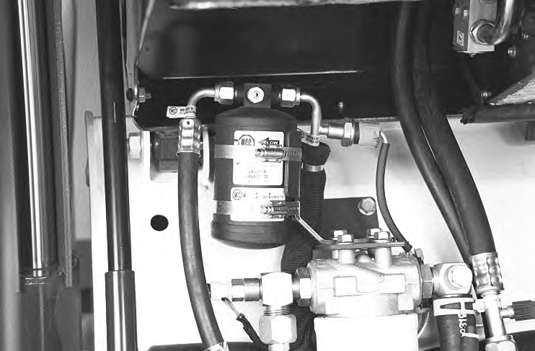
PRESSURE RELIEF VALVE
The pressure relief valve is located on the receiver drier assembly. This small brass
Valve is a safety feature that is designed to open and release the A/C charge if the
Pressure reaches 535 psi.

Slide 14
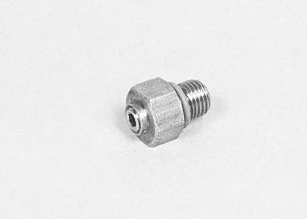
PRESSURE RELIEF VALVE

Slide 15
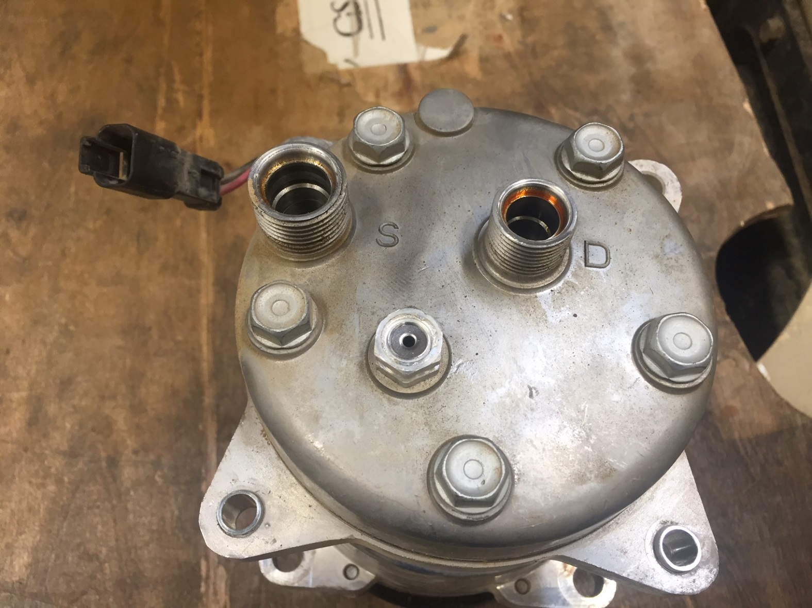
PRESSURE RELIEF VALVE

Slide 16
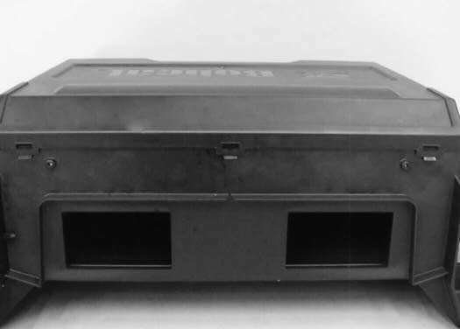
EVAPORATOR / HEATER COVER
DO NOT hook the tabs until later. Damage to the seal can occur allowing water to enter the housing causing
premature internal component failure.

